Slide 1
The DMAIC Method
www.leanstrategiesinternational.com

Slide 2
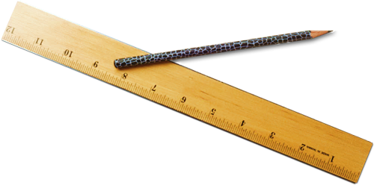
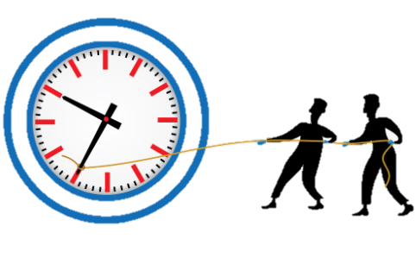
DMAIC- What is it?
The DMAIC Method is a problem solving methodology used within a six sigma strategy. The methodology focuses on improving business processes specifically through improving quality and reducing variation. It is an integral part of six sigma.
Define
Measure
Analyze
Improve
Control

Slide 3
DMAIC – WHY?
The DMAIC method is a formal structured approach to problem solving.
Each stage of the DMAIC method builds upon the previous stage.
An existing process has large deviations from the required customer need.
To solve problems at the source.

Slide 4
How does it work?
The DMAIC problem solving method follows a 5 step methodology.
Define
Measure
Analyze
Improve
Control
1.Define
5.Control
2.Measure
4.Improve
3.Analyze

Slide 5
Define
The first phase of the DMAIC method is the Define stage, it consists of defining the problem, defining the goal, understanding the process and translating the voice of the customer.
VOC Requirements
Critical to Quality
Define Project Charter
SIPOC Mapping
Value Stream Mapping
Define

Slide 6
Measure
The second phase of the DMAIC problem solving methodology is the measure phase.
Agree on CTQ’s.
Select appropriate measures
Gather baseline Data
Establish baseline performance.
Measure

Slide 7
Analyze
The third stage of the DMAIC method is analyze. In the analyze stage of the DMAIC method you will be reviewing data collected throughout the measure stage. Your goal is to turn effects into verified root causes.
FMEA
Cause and Effect
Pareto Analysis
Brainstorming
Analyze

Slide 8
Improve
In the fourth stage of the DMAIC methodology teams will begin to develop and implement solutions.
Kanban
Error Proofing
Standardization
Visual management
Improve work flow
Improve

Slide 9
Control
The control phase is the final stage of the DMAIC methodology. It ensures that the improvements made continue to work and meet the requirements of the customer.
Control Charts
Control Plans
Standard Operating Procedures
Reaction Plans
Control

Slide 10
Learn more about the DMAIC method by visiting our website.
Just Click Here!

